Slide 1

Polarion
Test Case Management System

Slide 2
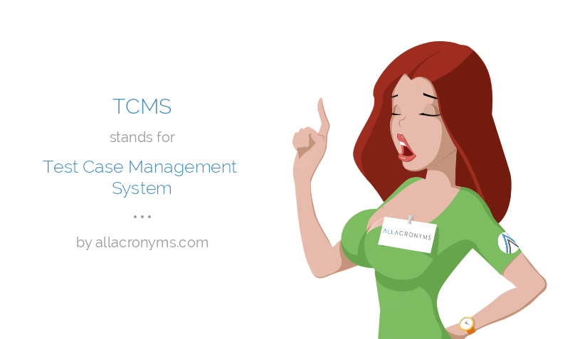
Preview
About Polarion QA
Differences between Polarion products
Positives of using Polarion QA
Negatives of using Polarion QA

Slide 3

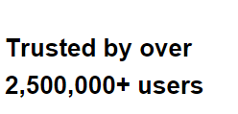

About Polarion QA
Comprehensive Test Case Management System
Web based
One of three main products of Polarion

Slide 4
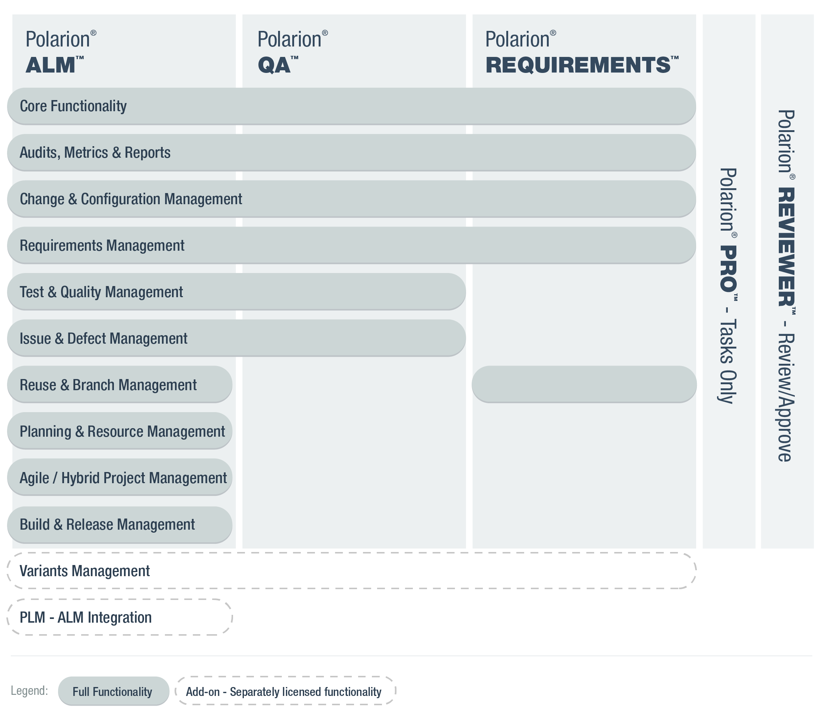
Differences between Polarion products
Polarion ALM
Polarion Reqiurements
Polarion QA

Slide 5

A quick demo

Slide 6

Positives
Common Platform
Compliance with standards
Collaboration with Microsoft Office Word and Excel
Full traceability
Web based

Slide 7

Negatives
It’s costly
Non-tradition view
Manual linking

Slide 8
Thank you

